Slide 1
Vocabulary Quiz 4 – Words 1-18 Level 2
1

Slide 2
Could you ___________ the food and put it in the fridge?

Slide 3
There has been a car ________ on the motorway, but no-one was injured.

Slide 4
Watch out! There is ___________ glass on the floor!

Slide 5
I can’t believe I’m __________ going to America!

Slide 6
She entered a _________ in the newspaper and won a car.

Slide 7
I would like to make an __________ to see the manager.

Slide 8
We got there at 6.30 but Martin had __________ left.

Slide 9
Please listen __________. I only want to say this once.

Slide 10
A large ___________ had gathered to hear the President speak.

Slide 11
My ________ job would be to work for Apple as an IT engineer!

Slide 12
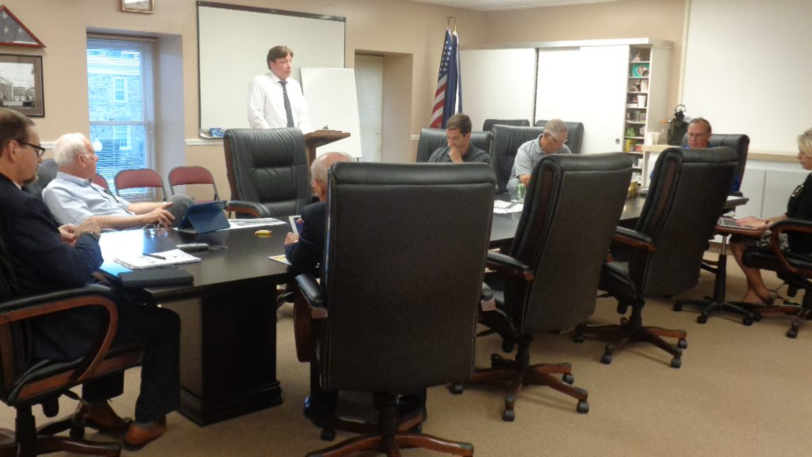
By nine o’clock, ___________ everybody had arrived.

Slide 13
Have you ________ been to Japan?

Slide 14
I’ll wait for you at the ___________ of the mall at 6 o’clock.

Slide 15
He is very ________. He can run a marathon (42 km) in less than three hours.

Slide 16
When you serve food to customers at McDonald’s, you should wear ___________ to make sure the food stays clean.

Slide 17
You need at ____________ 60% in the exam to pass.

Slide 18
What’s your _________ in life? Mine is to get a well-paying job with a large company.

Slide 19
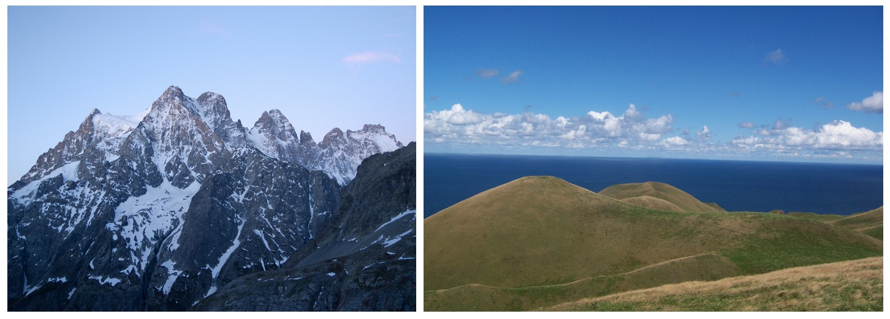
What is the difference between a ____________ and a mountain? It’s not as high, I think.

