Slide 1

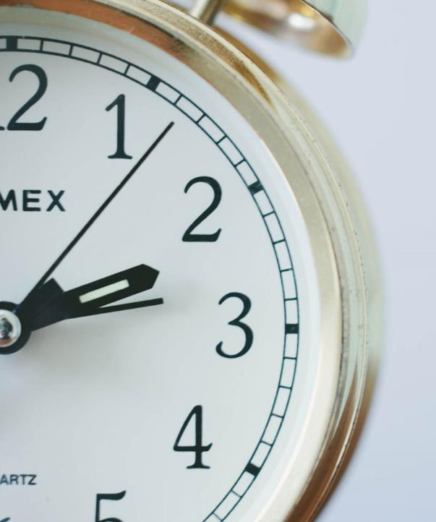
Vocabulary Quiz 2 – Words 19-35
Level 2
1

Slide 2

Microsoft Office is ___________ that everybody uses.

Slide 3
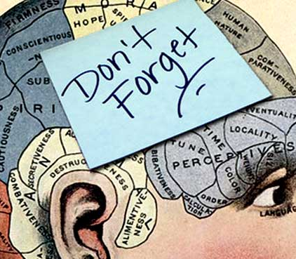
I forget everybody’s names. My __________ is not very good!

Slide 4
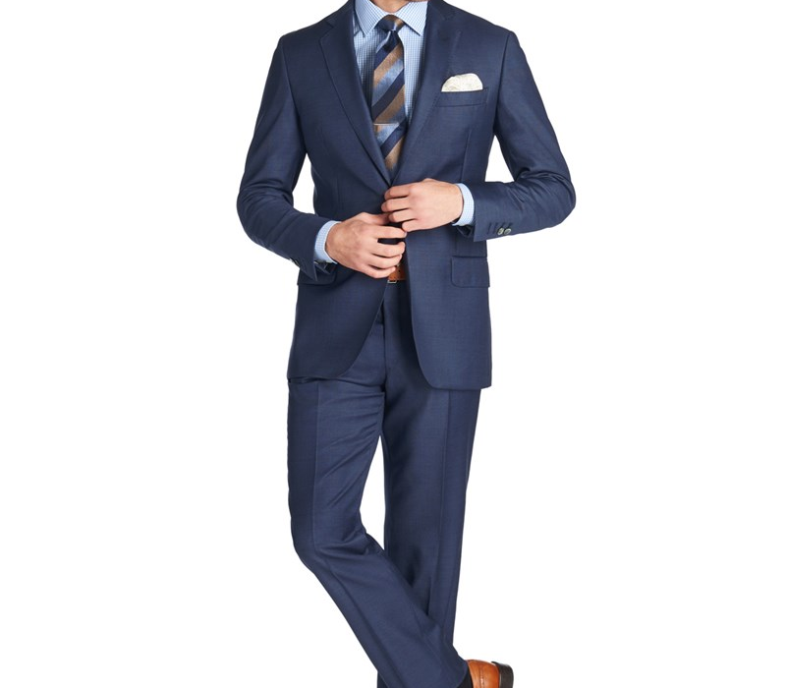
He’s wearing a very nice __________.

Slide 5

Don’t be so __________! Think about the good things!

Slide 6
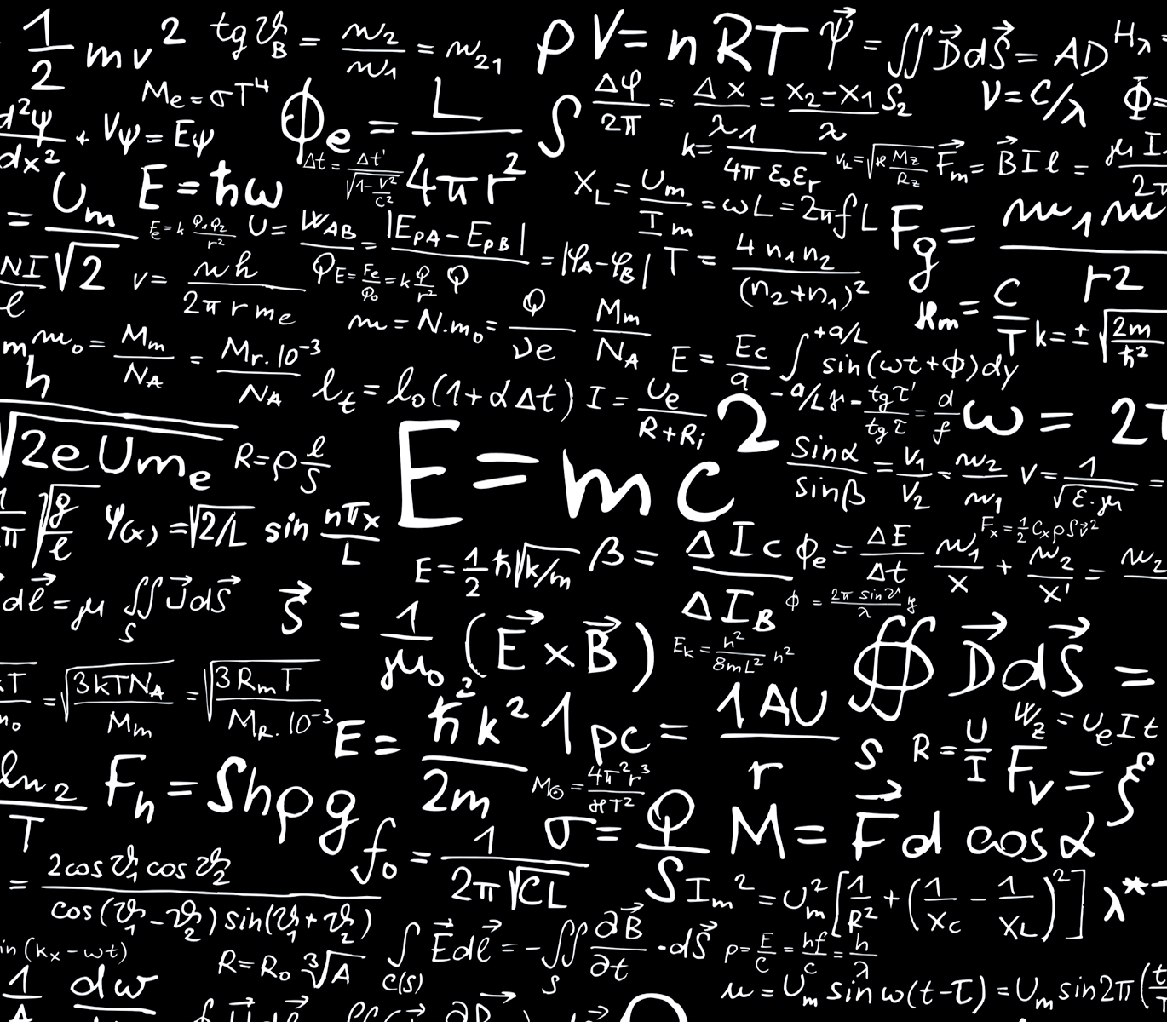
__________ is a very difficult subject.

Slide 7
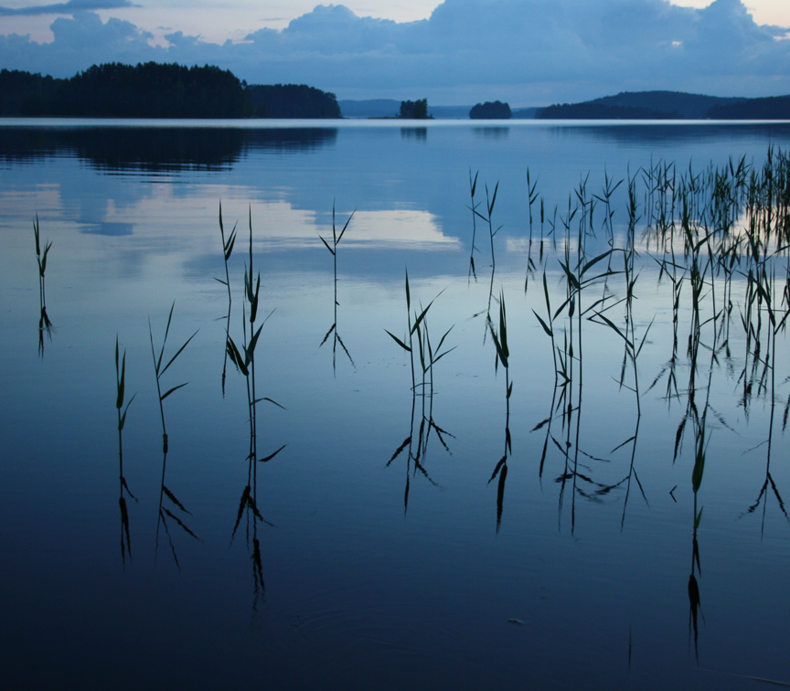
The water is very __________. No wind or waves at all.

Slide 8
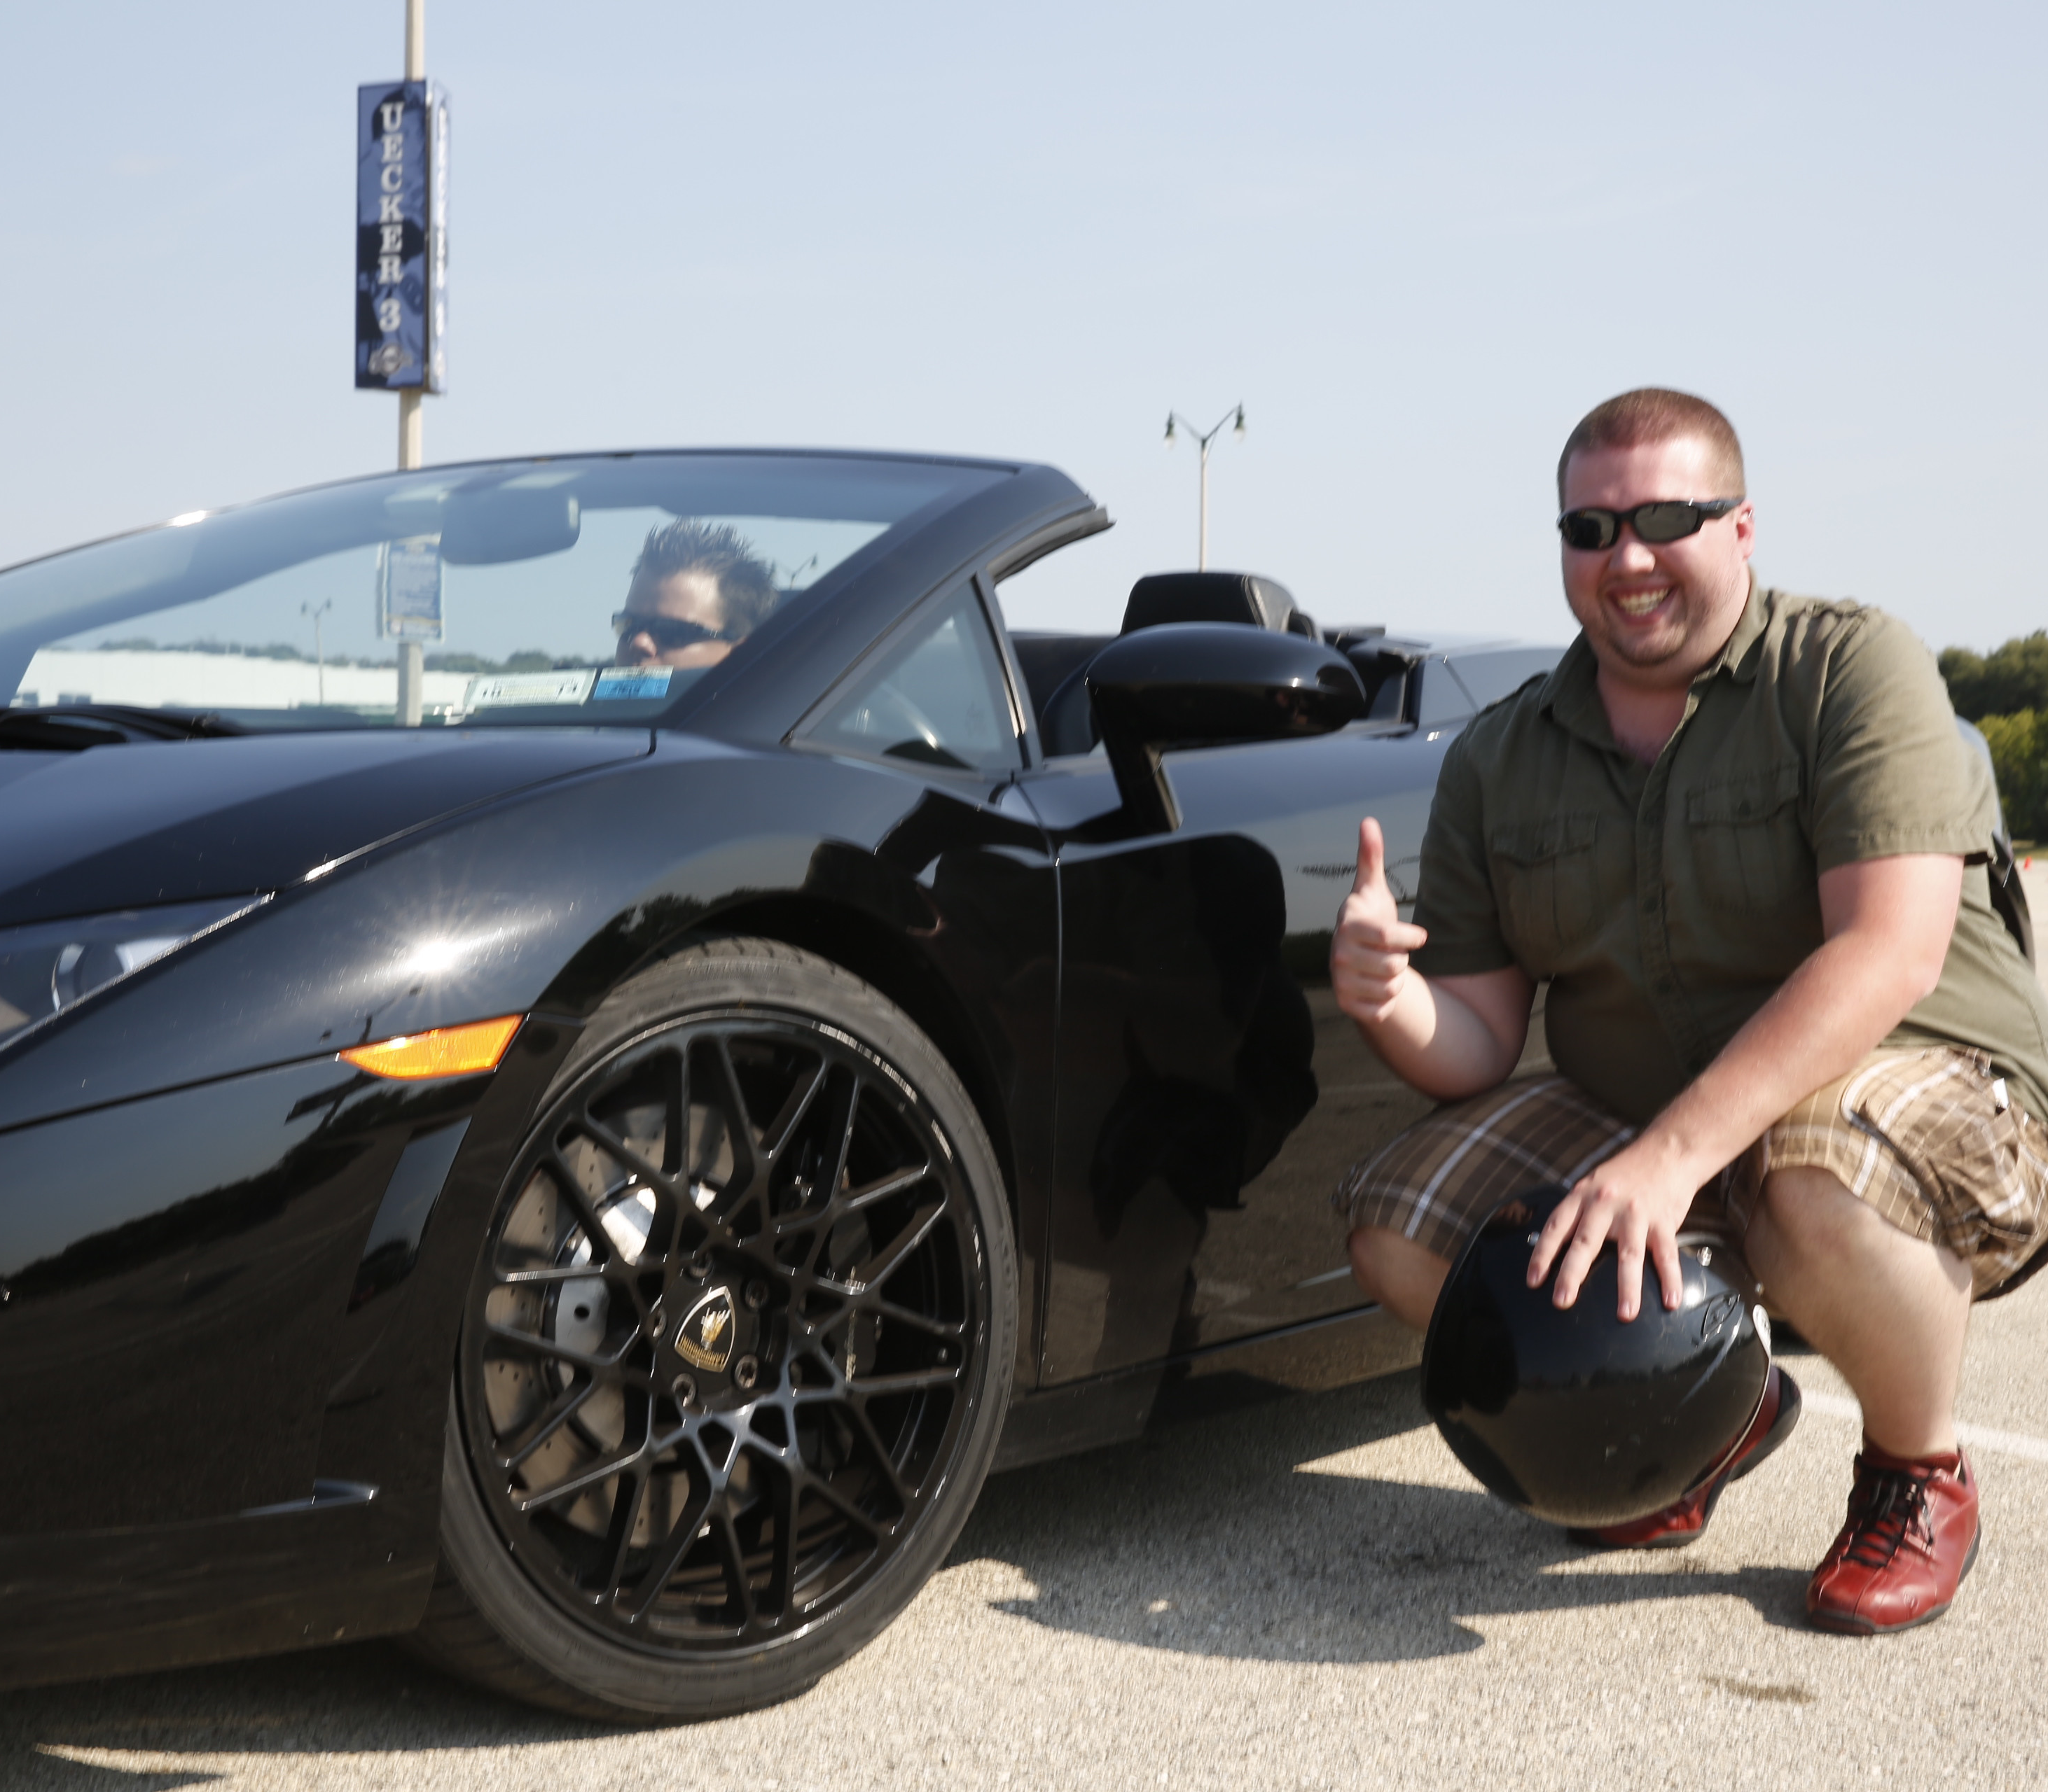
I __________ this car. It’s mine!

Slide 9

The __________ at this company are very helpful and positive.

Slide 10

I like doing __________ work at school. For example physics or chemistry.

Slide 11
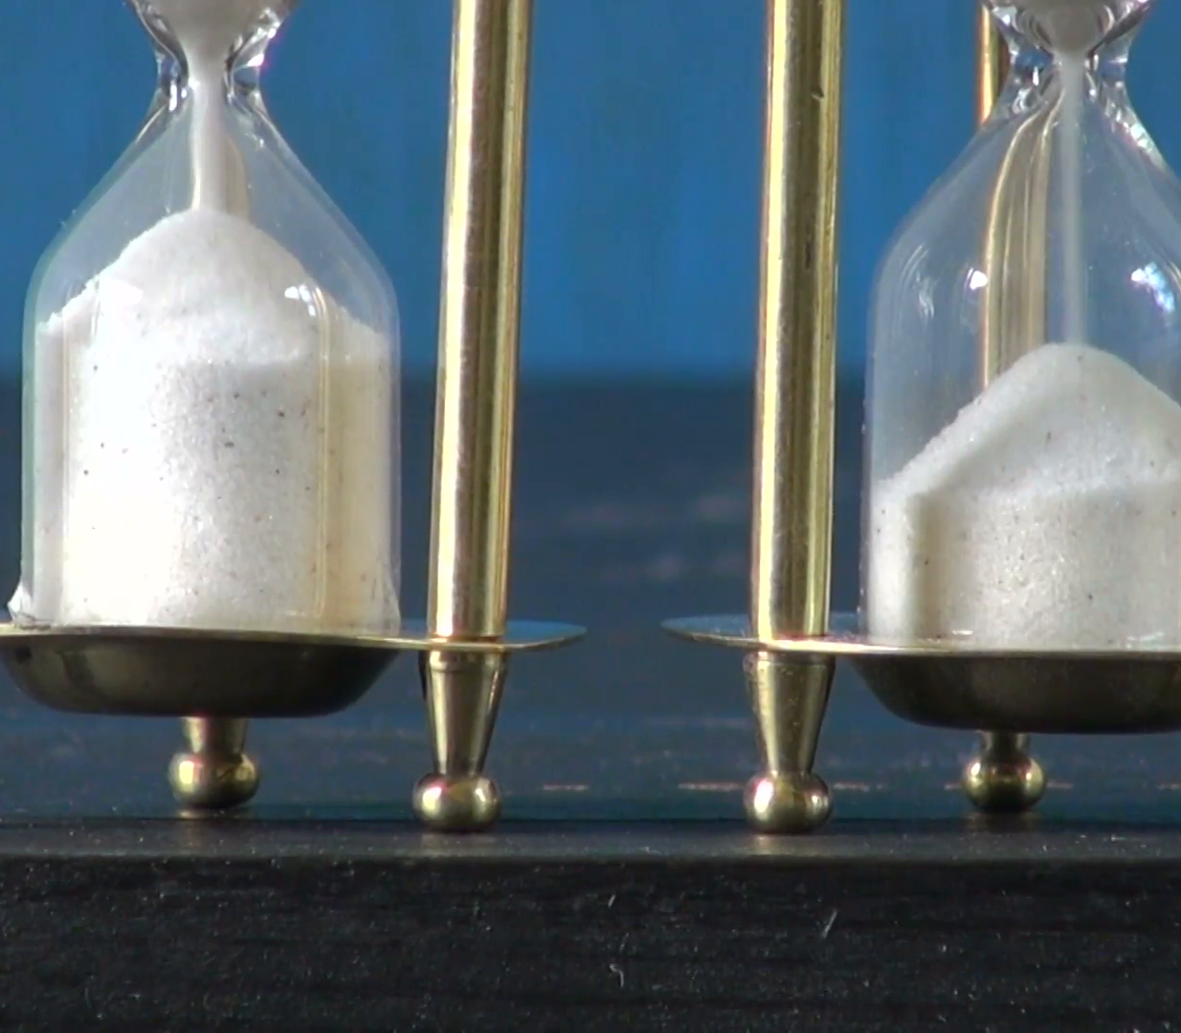
There is __________ sand in the hourglass to the right.

Slide 12
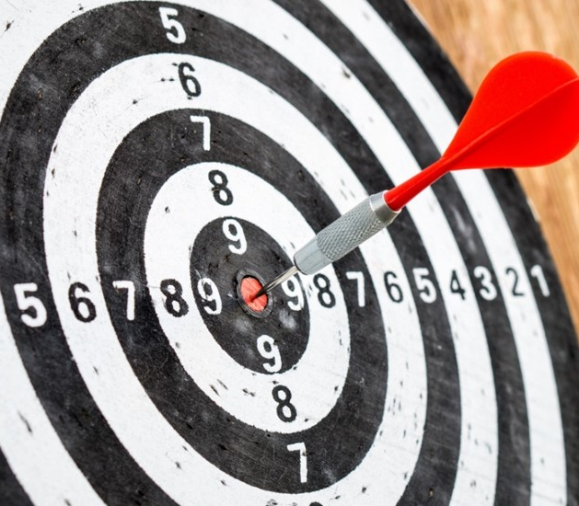
This was a __________ shot! Playing darts is not easy.

Slide 13
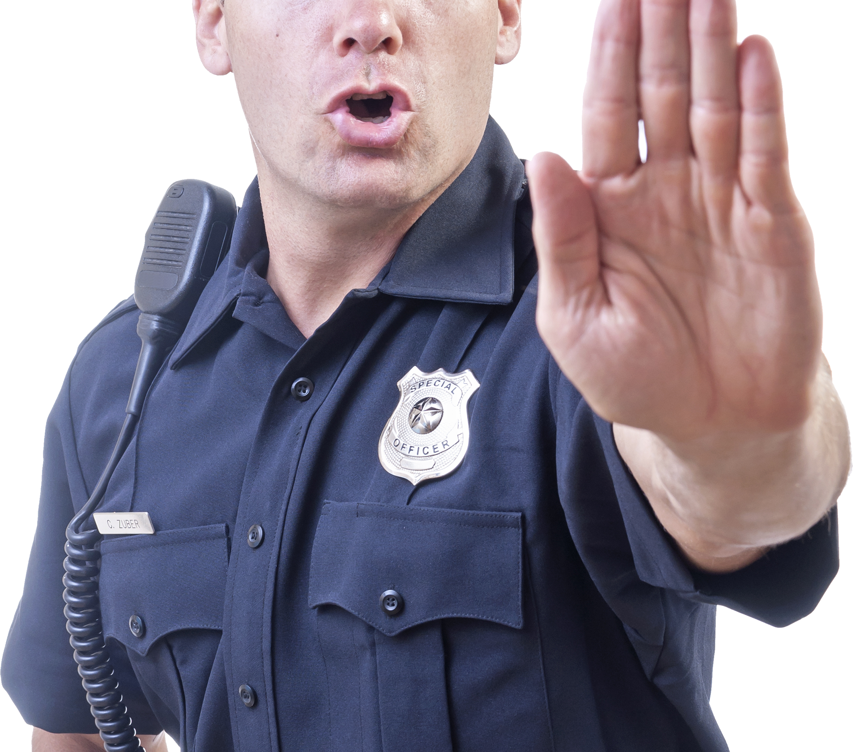
You __________ stop here!

Slide 14
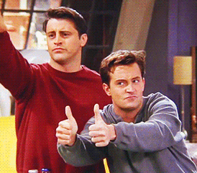
Friends is my favourite TV __________.

Slide 15
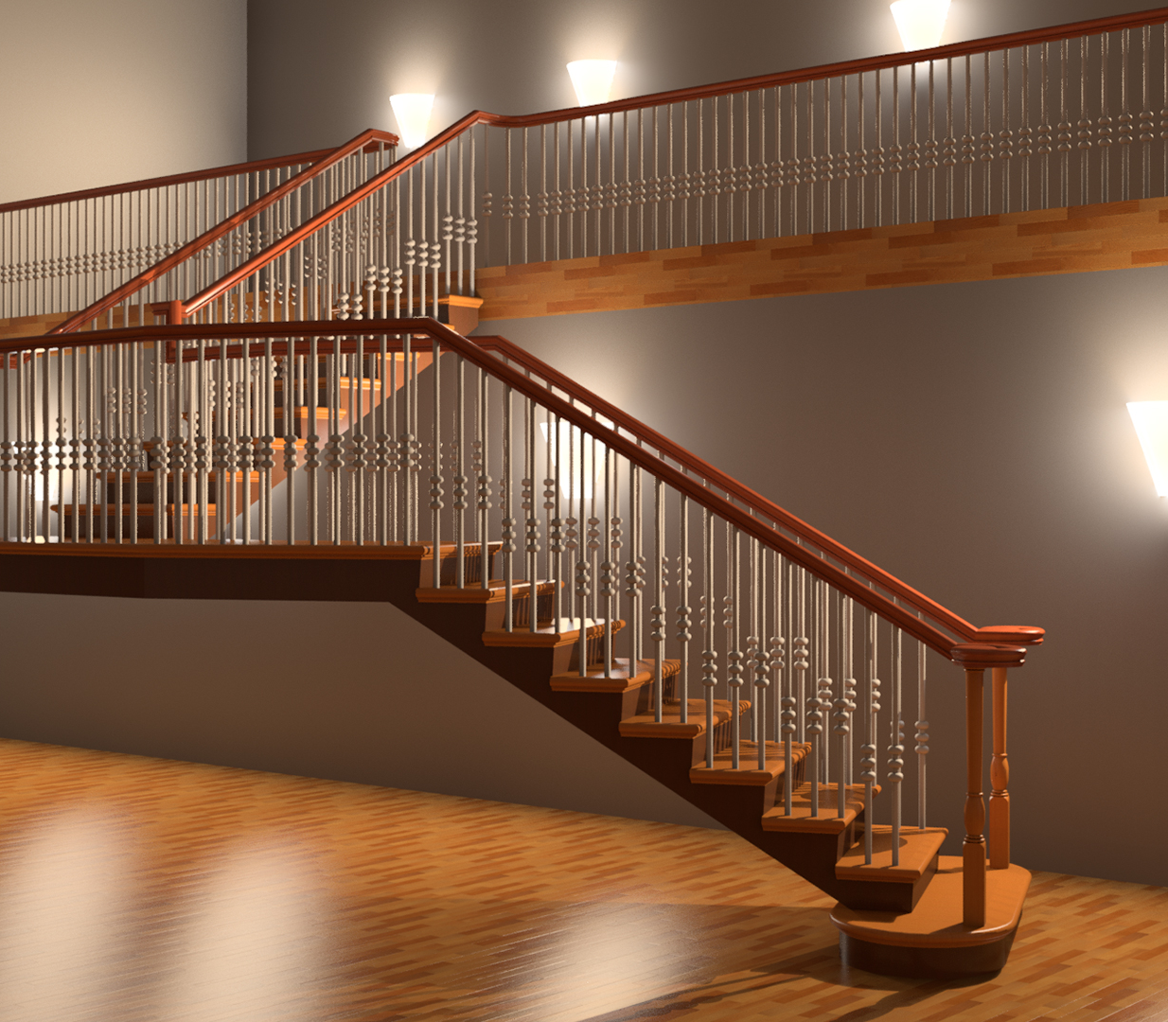
Go up the __________ .

Slide 16
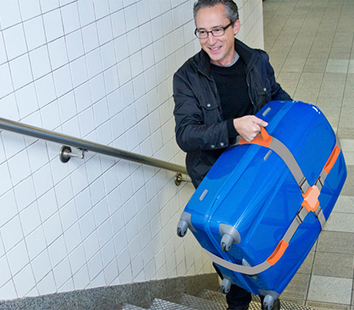
A lift here would be __________ !

Slide 17
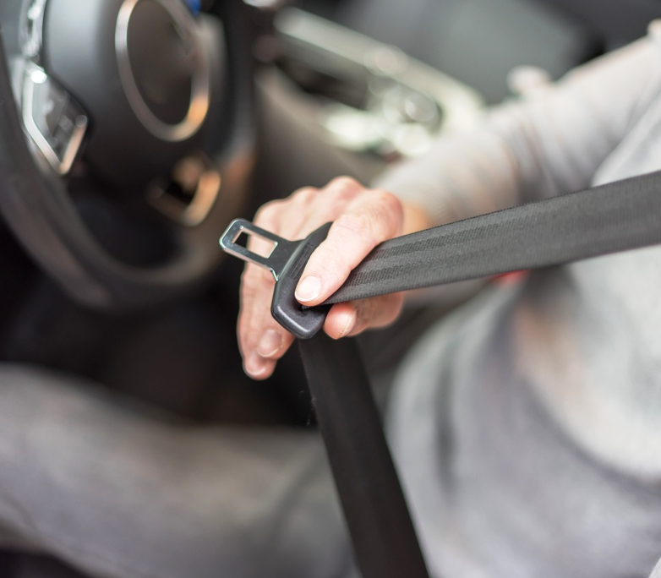
It _________ if you wear a seatbelt and you have an accident!

Slide 18
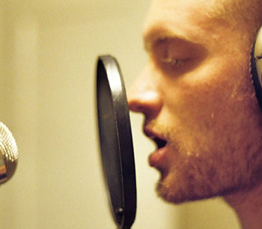
He will __________ a new song.

